Slide 1

LENDING CLUB CASE STUDY AMANDEEP MINHAS ARUN VINCENT J A

Slide 2
PROBLEM
Lending Club is the largest online loan marketplace, facilitating personal loans, business loans, and financing of medical procedures.
COMPANY PROFILE
Lending Club wants to understand the driving factors behind loan default, i.e. the driver variables which are strong indicators of default.
So as a data scientist working for Lending Club, we have to analyze the dataset containing information about past loan applicants using EDA to understand how consumer attributes and loan attributes influence the tendency of defaulters.
PROBLEM

Slide 3
APPROACH
DATA CLEAN
Clean the data by dropping the columns with null values & also rows
UNIVARIATE ANALYSIS
Analyze the distribution of the categorical variables and create the derived variables
BIVARIATE ANALYSIS
Do a correlation analysis between two variable
From the analysis and the observations publish the findings
RECOMMENDATION

Slide 4
DATA CLEANUP
Drop columns with all null values
Drop columns with high missing values and what won't contribute much to our analysis.
As emp_title has ~73% unique values, it's impact on our analysis won't be of much significance. So let's drop it.
Since loan_amnt, funded_amnt and funded_amnt_inv represent similar identity, it would be safe to just use 1 columns. We will use funded_amnt_inv as that represents the loan granted. We will also rename funded_amnt_inv to loan_amnt

Slide 5
DATA CLEANUP
As loan_status is our target column. We only want to figure out if a customer defaulted or not.
So We will create a new column named default_rate with will hold value of either 0 or 1 as such :-
0: Not Defaulted
1: Defaulted
We can also drop rows where loan_status is eq to Current as it will not contribute to analysis
Delete columns that are of data that are either collected after a loan is grated to the customer/have singular for all rows/ do not contribute to analysis.
Convert term to numeric field
Drop column member_id as it has all unique values which do not contribute to analysis.
Remove Outliers from Annual Income, Loan Amount, Interest Rate
Since there are very few records for Grade E, we will consider it an outlier and drop that column.

Slide 6
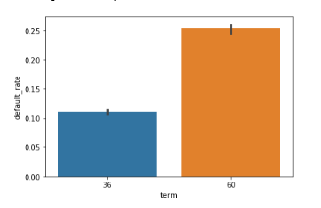
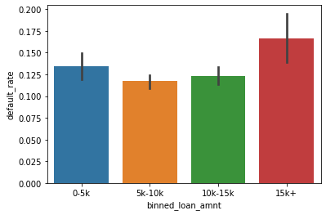
ANALYSIS
Term Analysis
10% of the loans taken for a term of 36 months defaulted.
21% of the loans taken for a term of 60 months defaulted.
Analysis with respect to Loan Amounts
~13% of the customers who borrow less than 5k tend to default.
Lowest Risk ~12% of the customers who borrow in the range of 5k to 10k tend to default.
~12% of the customers who borrow in the range of 10k to 15k tend to default.
Highest Risk ~17% of the customers who borrow more than 15k tend to default.

Slide 7
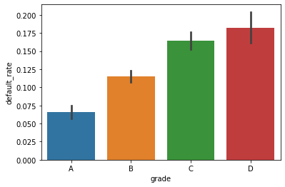
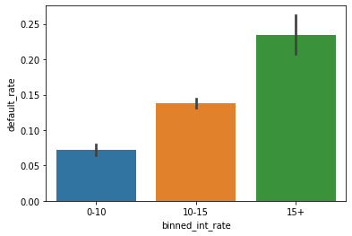
ANALYSIS
Grade:
As expected, as the grade increases, the risk or default increases as well.
Lowest Risk Chances of default are minimum for loans given out to customers with grade A (~7%)
Highest Risk Chances of default are maximum for loans given out to customers with grade D (~18%)
Analysis with respect to Interest Rate
~low ~7% default when interest rate is less than 10%.
~ Medium ~14% default when interest rate is between 10% to 15%.
~ High ~23% default when interest rate is above 15%.
Interest Rate and Tendency to Default are directly proportional. As one increases, other increases as well.
.

Slide 8
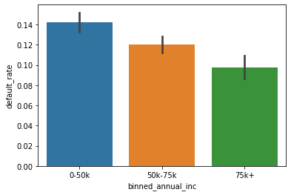
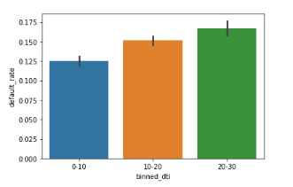
ANALYSIS
Analysis with respect to Annual Income
As income increases, the chances of customer defaulting decreases.
~14% of customers with annual income of less than USD 50k tend to default.
~12% of customers with annual income between USD 50k to USD 75k tend to default.
~10% of customers with annual income above USD 75k tend to default.
Analyze DTI:
After Creating buckets for DTI ranging from 0-10, 10 to 20 and 20 - 30 and plot against default rate it is observed that as DTI increases, the tendency to default increases

Slide 9
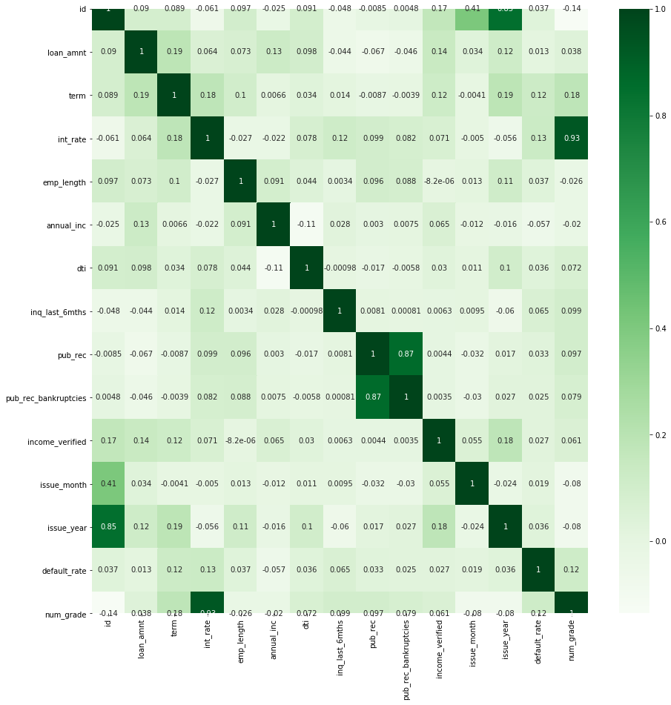
ANALYSIS
Correlation map

Slide 10
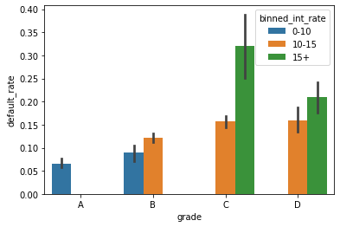
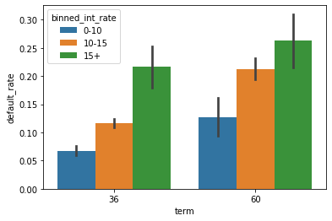
ANALYSIS
Interest Rate | Grade
Lowest Risk → Chances of default are minimum for loans given out at interest rate of less than 10% to customer with Grade A. (7%)
Highest Risk → Chances of default are maximum for loans given out at interest rate of more than 15% to customer with Grade C. (32%)
Interest Rate | Term
Lowest Risk → Chances of default are minimum when granting a loan for tenure of 36 months with interest
rate of less than 10% (7%)
Highest Risk → Chances of default are maximum when granting a loan for tenure of 60 months with interest
rate of more than 15% (26%).

Slide 11
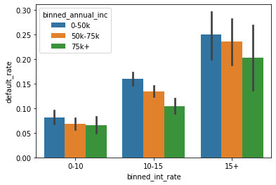
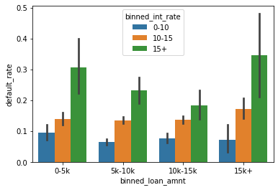
ANALYSIS
Interest Rate | Annual Income
Lowest Risk → Chances of default are minimum (~7%) for loans given out at an interest rate of less than 10% to customers with annual income of more than 75k
● Highest Risk → Chances of default are maximum (~25%) for loans given out at an interest rate of more than 15% to customers with annual income of less than 50k
Interest Rate | Loan Amount
Lowest Risk → Chances of default are minimum for a loan of over 5k-10k with interest rate of less than 10% (6%).
Highest Risk → Chances of default are maximum for a loan of over 15k with interest rate of more than 15% (35%).

Slide 12
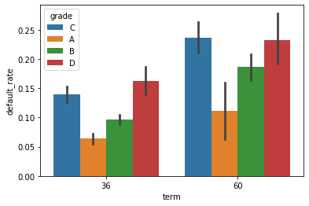
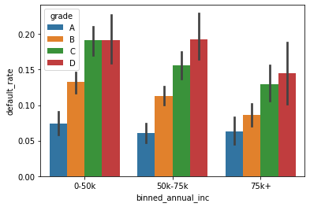
ANALYSIS
Grade | Term
Lowest Risk → Chances of default are minimum when giving out loan to customer with A grade for a term of 36 months (~6%)
Highest Risk → Chances of default are maximum when giving out loan to customer with C grade for a term of 60 months (~24%)
Grade | Annual Income
Lowest Risk → Chances of default are minimum when granting loans to customers with annual income of 50k - 75k and with grade A (~1%)
Highest Risk → Chances of default are maximum when granting loans to
customers with annual income of less than 50k and with grade C or D (~19%)
customers with annual income of 50k-75k and with grade D (~19%)

Slide 13
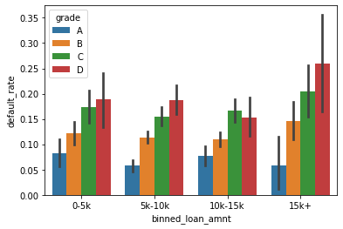
ANALYSIS
Grade | Loan Amount
Lowest Risk → Chances of default are minimum when granting loan of 5k - 10k to customers with grade A (~6%)
Highest Risk → Chances of default are maximum when granting loan of more than 15k to customers with grade D (~26%)

Slide 14
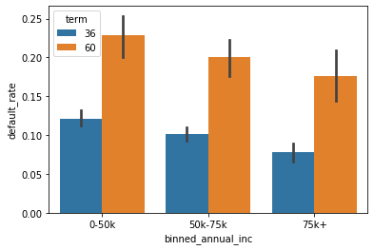
ANALYSIS
Term | Annual Income
Lowest Risk → Chances of default are minimum when giving out a loan to a customer with annual income of 75k+ for a term of 36 months (~8%)
Highest Risk → Chances of default are maximum when giving out a loan to a customer with annual income of less than 50k for a term of 60 months (~23%)

Slide 15
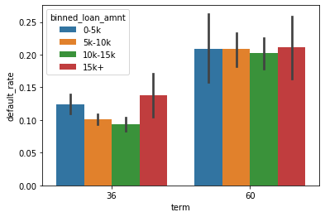
ANALYSIS
Term | Loan Amount
Loans given for USD 10-15k tend to do better and have less change of defaulting.
For 36 months
● chances of default are minimum for loans ranging between 10k to 15k. (~9%)
● chances of default are maximum for loan of more than 15k. (14%)
For 60 months
● chances of default are minimum for loans ranging between 10k to 15k. (~20%)
● chances of default of all others loan amounts are 21%
Overall
● Lowest Risk Chances of default are minimum when giving out loan in the range of USD 10k to 15k for a term of 36 months (~9%)
● Highest Risk Chances of default are maximum when giving out loan for any amount for a term of 60 months

Slide 16
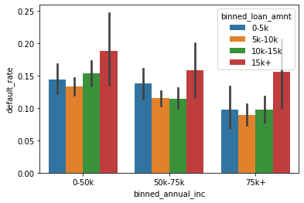
ANALYSIS
Loan Amount | Annual Income
For Income 0-50k
● chances of default are minimum for loans ranging between 5k to 10k. (~13%)
● chances of default are maximum for loans greater than 15k. (19%)
For Income 50k-75k
● chances of default are minimum for loans ranging between 5k to 15k. (~11%)
● chances of default are maximum for loans greater than 15k. (16%)
For Income 75k+
● chances of default are minimum for loans ranging between 5k to 19k. (~9%)
● chances of default are maximum for loans greater than 15k. (16%)
Lowest Risk → chances of default are minimum for loans ranging between 5k to 10k granted to customer with income of greater than 75k (~9%)
Highest Risk → chances of default are maximum for loans greater than 15k granted to customer with income in the range of 0 to 50k (19%)

Slide 17
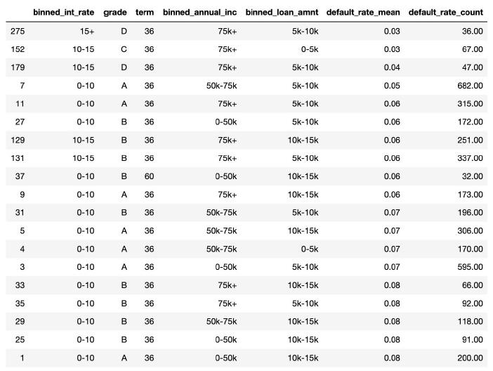
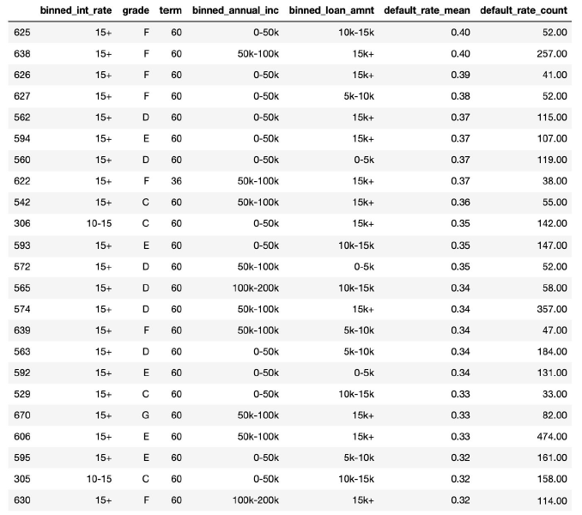
RECOMMENDATION
RECOMMENDATION
GOOD LOAN
BAD LOAN

Slide 18
RECOMMENDATION
From the tables formulated in the last slide
GOOD LOAN - Loan which has a default rate of less than 8%
BAD LOAN - Loan which has a default rate of more than 30%
Good/Bad | GRADE | TERM | INTEREST RATE | LOAN AMOUNT | ANNUAL INCOME
Good Loan | A | 36 | less than 10%
 | B |  | less than 15% | 5k -15k
 | C |  | 10% - 15% | less than 5k | above 75k
 | D |  | above 10% | 5k -15k | above 75k
Bad Loan | C | 60 | 10% - 15% | above 10k | below 50k
 | D | 60 | above 15% | 5k -10k | below 50k
We strongly recommend the club avoid giving loans to the people with combination in the Bad Loan category.
Also we found that there is high chance of not default for people who come under Good Loan category

Slide 19
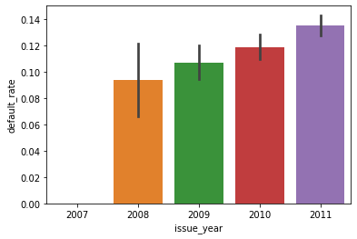
Interesting Fact
RECESSION FACTOR
Default by Year:
During the analysis it was observed that there was an upward trend year on year, going from 12% in 2009 to 16% in 2011 which may be due to the Recession.
This can be taken as separate case study to find whether
People defaulted more due to Recession, or
There was a Recession as more people Defaulted in those years.

